Slide 1
Level of Detail
LOD

Slide 2
Level of Detail
Introductions / The Basics
Impostors
Switching
Selecting
Time-Critical Rendering using LODs
Tessellation

Slide 3
Introductions
The Basics

Slide 4
The Basics
Level of Detail refers to using different representations of render data to improve frame rate
This render data can mean a lot of things such as different mesh data, textures or even shaders
The idea is that we can use simpler render data to represent less important items to the scene in order to reduce rendering cost

Slide 5
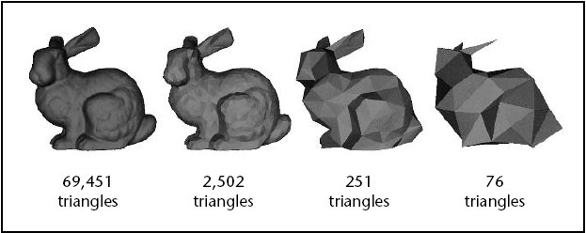
The Basics
Mesh LODs with reduced number of polygons to represent the same data.

Slide 6
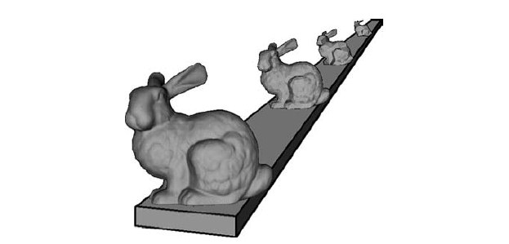
The Basics
As the importance of the render data reduces we can use a cheaper LOD

Slide 7
The Basics
LODs do not have to be limited to just mesh data, which will mostly only help in the vertex processing stage.
With modern hardware we are likely to get the most optimization through the use of simpler shaders, as long as we are not introducing more context switches.
High importance uses Parallax Occlusion Mapping
Medium importance used Normal Mapping
Low importance uses basic lighting

Slide 8
Impostors

Slide 9
Impostors
The term “Impostors” in reference to LODs is not the most well defined term.
Some might call a simple model an Impostor
For our use we will specifically mean a very simple model, so simple it only has 2 triangles to represent a billboard.

Slide 10
Impostors
A Billboard is just a polygon that always faces the camera.
A simple way to achieve this is to have the billboard do the LookAt algorithm with the camera as its target.
We can then texture the billboard to represent some object.
If it is not focused on, it can be hard to tell it is a billboard at all.

Slide 11
Impostors
A simple Impostors for LOD solution would just use a static picture of the model to be represented.
A more advanced, and costly, technique is to periodically render the actual object to an off screen render target and use that texture on the billboard.
This allows for any dynamic changes to be represented, such as changes in orientation.
As long as we do not update the texture every frame it should conceivably be cheaper than actually rendering the object normally.

Slide 12
Switching

Slide 13
Switching - DLOD
The simplest form of LOD switching is called Discrete LOD, or DLOD
With DLOD, the artist will provide a number of LODs for each model
An algorithm is used to test the importance of the model in the scene then this importance is used to select which LOD to render

Slide 14
Switching - DLOD
The switching from one LOD to another will result in “popping”
Popping is just the visible anomaly of using one mesh one frame and another the next
This is a fairly common issue with LODs in games. This effect is so common, it is suggested that people that play video games a lot, stop noticing it over time.

Slide 15
Switching - DLOD
The popping in DLOD can be very bad if the selecting algorithm results in the LOD switching back and forth between 2 LODs from frame to frame.
This can be triggered by subtle changes in the users view.
A common way to improve this is to use a hysteresis in the selecting algorithm.

Slide 16
Switching - Hysteresis
Hysteresis – The phenomenon in which the value of a physical property lags behind changes in the effect causing it.
The idea is to have some overlap in importance amount when selecting the LOD
Switch at higher importance value while increasing and a lower value while decreasing.

Slide 17
Switching - Blending
Another common technique for switching to reduce popping is to use blending.
Instead of discretely switching from one LOD to another we will have a range where we render 2 LODs with inverse alpha amounts.
This will greatly reduce the popping, but will actually cost more to render the object while it is switching from one LOD to another.

Slide 18
Switching - Blending
Hey our deferred rendering system does not support alpha blending in the main pipeline.
We can use a “screen door effect” instead.
The basic idea is to skip some pixels when rendering an object we want to appear to be fading out.
When is “alpha” is 50% we might discard every other pixel rendered.

Slide 19
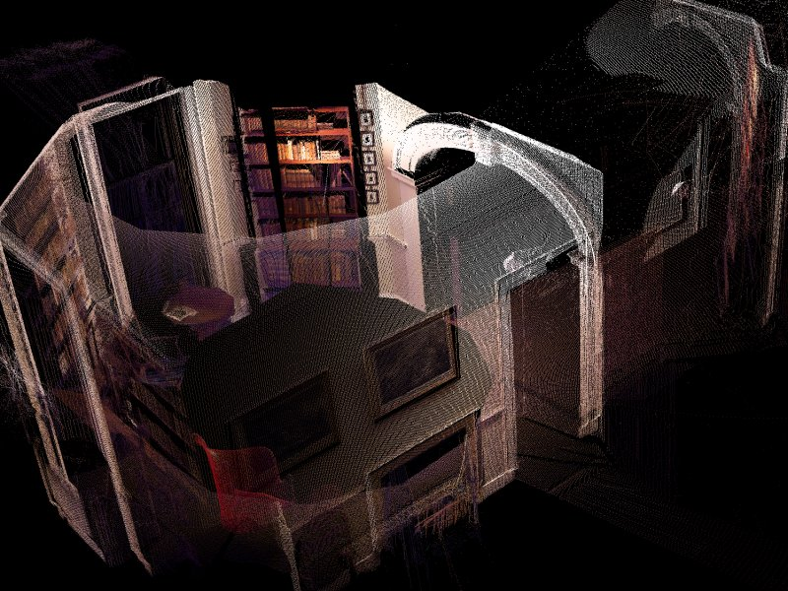
Screen Door Effect

Slide 20
Switching - Alpha
Alpha LOD is an LOD system that uses only one instance of a mesh.
The mesh is rendered with transparency that increases as the mesh becomes less important.
This systems does not have popping, but also does not result in any savings until the object is completely transparent and thus no longer needs to be rendered.

Slide 21
Switching - CLOD
CLOD refers to Continuous Level of Detail
The basic idea with CLOD is that we will reduce the number of polygons in a mesh procedurally at run-time as the importance decreases.
The typical way to reduce polygons is through edge collapses.
Basically, take the opposite points of an edge of a triangle and move them so that they are the same point and *poof* the triangle is gone.

Slide 22
Switching - CLOD
These edge collapses can be performed in such a way that the mesh always has right number of polygons to represent it for its current importance.
CLOD also has less popping.
If the merging of points in the edge collapsing is done over time there will be very little noticeable changes, this is called geomorphing

Slide 23
Switching – View Dependant
View-Dependant LOD is a technique that is very similar to CLOD
The difference is that portions of a mesh will use differing polygonal resolutions dependant upon the view angle.

Slide 24
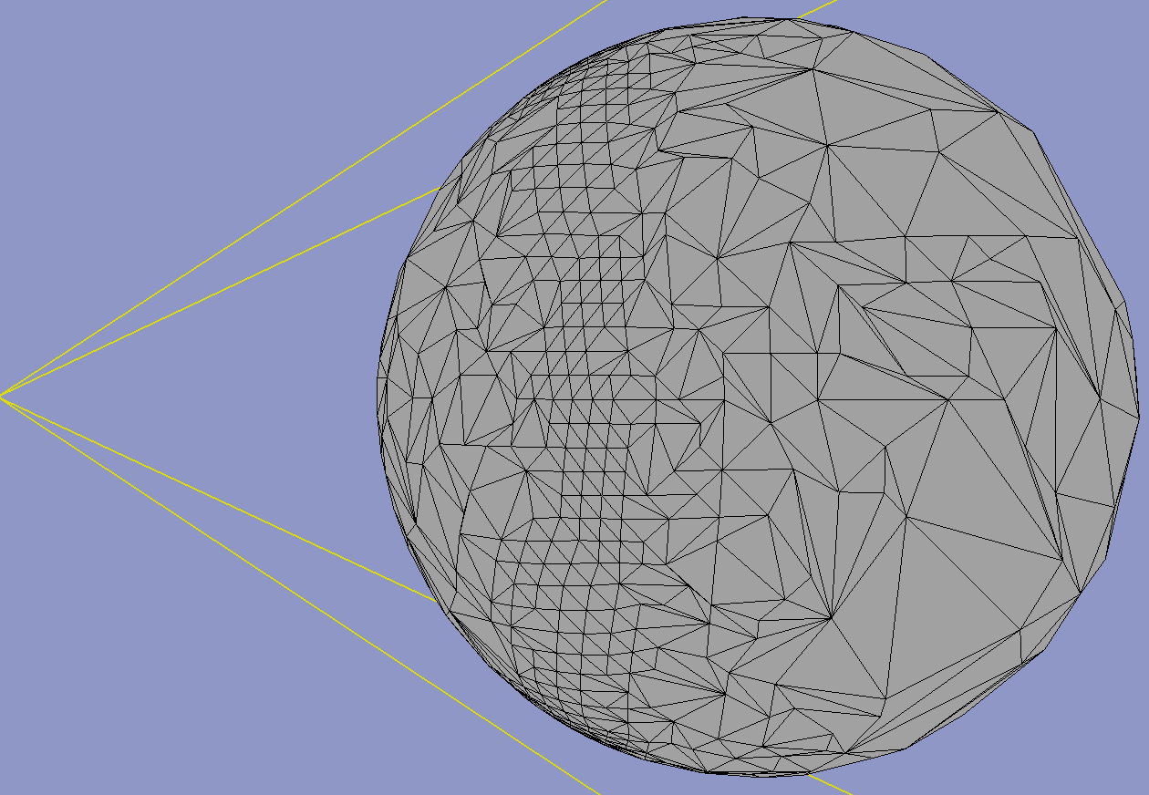
Switching – View Dependent
We will use a higher resolution for the silhouette portions of the mesh than the interior.

Slide 25
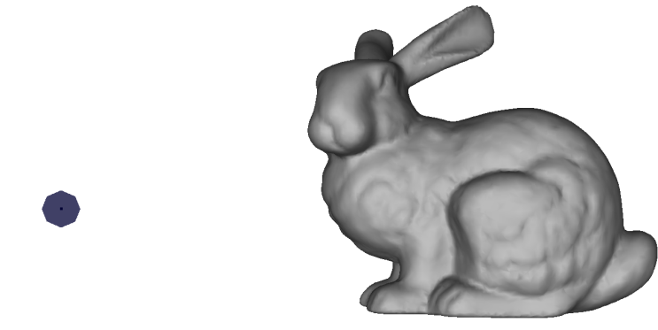
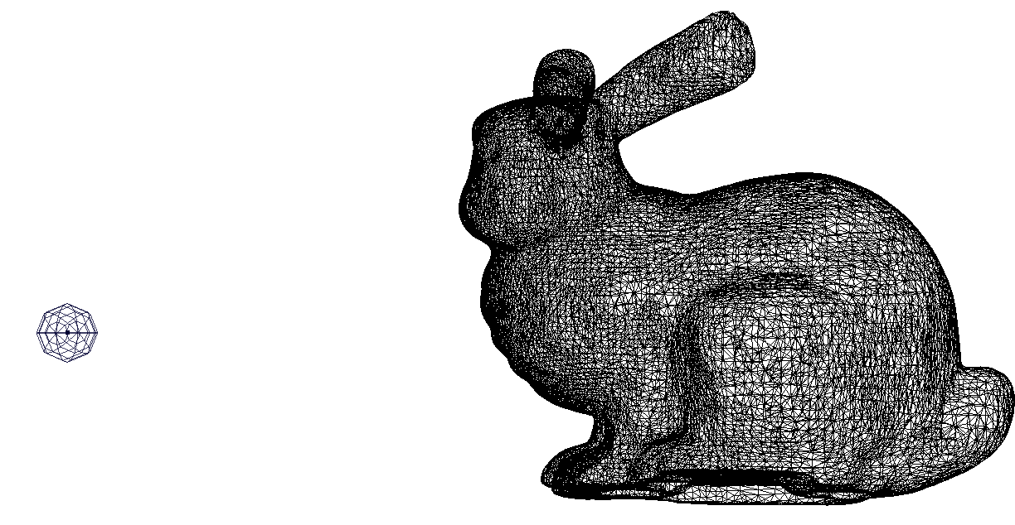
Switching – View Dependent
We will use a higher resolution where the user is looking than the peripheral area.
34,321 triangles

Slide 26
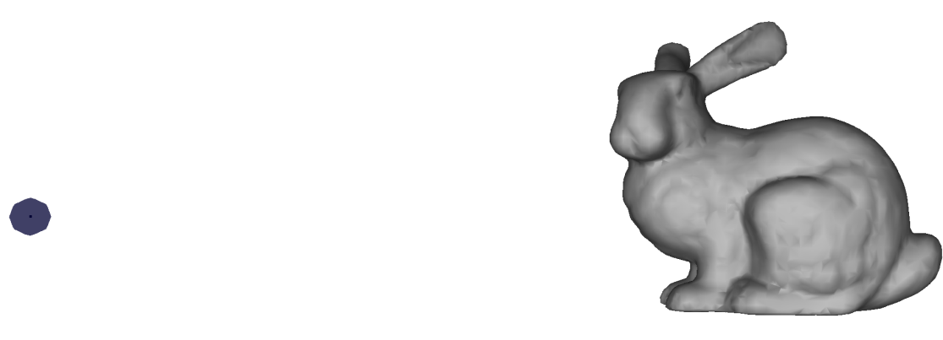
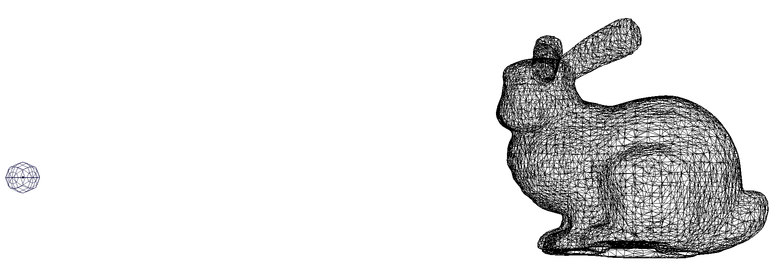
Switching – View Dependent
We will use a higher resolution where the user is looking than the peripheral area.
11,726 triangles

Slide 27
Selecting

Slide 28
Selecting
There are two common criteria used for defining the importance of an object in a scene.
Range/Depth based
Projected Area
These will commonly be defined for objects as they pass the frustum culling step.

Slide 29
Selecting - Range
Simple idea, the further away an object is in our view the less important it is.
The “depth” of an object can usually be found as part of the frustum culling routine and kept to be used to select what LOD should be used.
The main problem with this selection routine is that it does not take into account the size of an object.
A large object further away than a small object can be more important to the scene than the latter.

Slide 30
Selecting – Area Based
The idea with area based selection, is that objects which cover more of the viewable area are more important, and get a higher LOD.
We will need to find the area of an object, after it is projected into screen space.
The area of the object in world space is not useful as it could be so far away that it will look tiny, even if it is a very large object.

Slide 31
Selecting – Area Based
Finding the area of a complex model is difficult, so we will use a simple bounding volume instead, like a sphere.
We could project the center of the sphere, and any point on the edge of the sphere into screen space and get the distance between them, but there is a faster more common algorithm to estimate the radius.

Slide 32
Selecting – Area Based
P = (nr) / D dot (C – V)
P = projected radius
n = near clip distance
r = actual radius
D = view direction
C = center point of sphere
V = viewer position

Slide 33
Selecting – Area Based
P = (nr) / D dot (C – V)
The D dot (C-V) will be the distance the sphere center is from the view plane.
The (nr) part is effectively a constant, as we will rarely change the near clip plane, or the radius of a bounding volume at runtime.
A constant divided by a variable follows the form of an inverse function, like the inverse of X is 1/X.

Slide 34
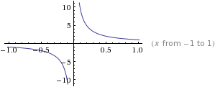
Selecting – Area Based
P = (nr) / D dot (C – V)
This formula works fine for comparing, but the values to switch at can be weird to define since the slope of the result is non-linear.
You would likely have an artist play around with the numbers to find acceptable switching points.

Slide 35
Time-Critical rendering using LODs

Slide 36
Time-Critical Rendering
Time-Critical Rendering is rendering within a fixed set of time.
We make adjustments to how we render in order to always fit in the locked amount of time.
If we have spare time, we can wait, that is the easy part.
If we have too little time, we have to reduce what we do. We can use LODs for this.

Slide 37
Time-Critical Rendering
There are both predictive and responsive methods to do this.
A responsive method would go over the max time one frame, and reduce LODs to compensate the next.
A predictive method would estimate the cost of rendering at given LODs and reduce to fit in the given time, taking into account the importance of a given object.

Slide 38
Tessellation

Slide 39
Tessellation
Hardware tessellation is a new feature in DirectX 11
Hardware tessellation is simply breaking up a polygon into more polygons.
We can do this to add more detail through the use of displacement maps.
A displacement map is like a height map that can be applied to a non-planar surface.
This works in a very similar manner to our tangent-space normal maps

Slide 40
Tessellation
These displacement maps can have a high resolution of values for heights.
If we have a low tessellation, or poly count, we get few samples of the displacement map and less detail.
As we increase tessellation, the detail will go up.
We can adjust the tessellation amounts as a function of our LOD selection.

Slide 41
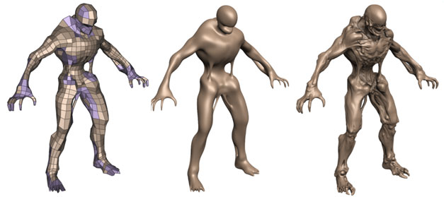
Tessellation
A course model is tessellated, then has a displacement map added

